Slide 1
Case 1
Thanh, Priya, Divya, Ralf, Syed, Tanjit

Slide 2
Find all stocks that are currently below the 5th percentile of their historical prices
Find all stocks that are currently above the 95th percentile of their historical prices
Choose 5 stocks that seem interesting to buy and hold for a month
Overview

Slide 3

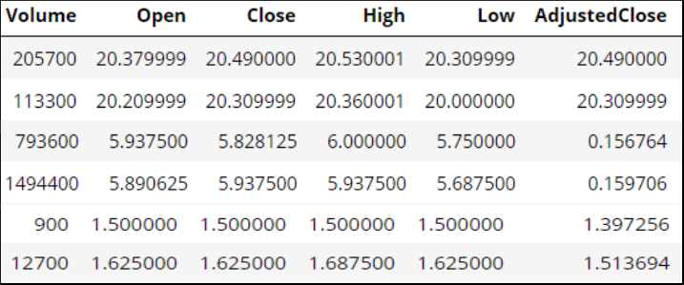
Below 5th Percentile
Using df.AdjustedClose.quantile to create below 5th percentile

Slide 4
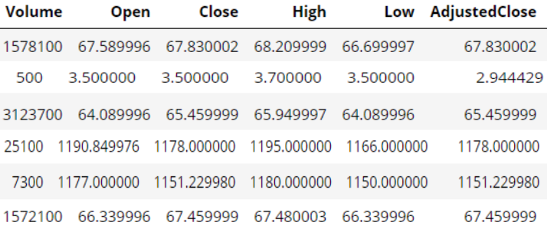
Above 95th Percentile
Using < to compare our previous df.AdjustedClose code to .95 quantile

Slide 5
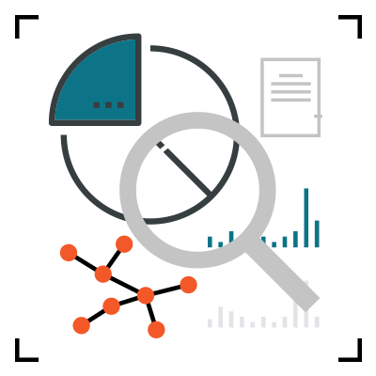
Our Stock Picks
TPG Specialty Lending (TSLX)
S&P Global (SPGI)
Atlantic American Corporation (AAME)
Association of American Medical Colleges (AAMC)
Agilent Technologies (A)

Slide 6

$19.86 as of 2/26/2019
TPG specialize in finance providing financing solutions to middle market companies principally located in the US.
TSLX continues to have excellent dividend coverage with a annual payout of $1.54
2018 Q4 Earnings and Revenues surpasses estimates - providing a good investment.

Slide 7

Stock Price $241.48
S&P Global is a data analysis company that helps clients make decisions on real world data.
One of the strongest dividends in the market. Recently increased by 14% for $0.57 per dividend.
A bearish stock and safe investment

Slide 8

$2.52 as of 2/26/2019
A successful banking firm
Declared dividend at $0.02
With a low price and dividend yields, make this a great stock to buy

Slide 9

$33.77 as of 2/26/2019
Altisource is an asset management company that provides portfolio management and corporate governance services to real estate related investment vehicles.
Stock is currently below it’s peak point - great stock to invest

Slide 10

$79.30 as of 2/26/2019
Agilent provides analytical instruments, software, services and consumables for the laboratory workflow
Agilent has is relatively a strong company beating EPS estimates and revenue estimates
Agilent Technologies three-year forward CAGR of 10% is moderate and expected to grow with the increasing technology developments of the company

Slide 11
Questions

